Slide 1

Practice 3 Operational Amplifiers
Nikolay Nikolaev (nanikolaev@itmo.ru)
Nikolai Poliakov (polyakov_n_a@itmo.ru)
Roman Olekhnovich (r.o.olekhnovich@mail.ru)
Notes:
Hello. We are starting our Practice 3 «Operational amplifiers. Wien Bridge Oscillator »

Slide 2
Summary
Wien Bridge Oscillator
Practice work 2: simulation
Control test

Slide 3
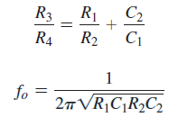
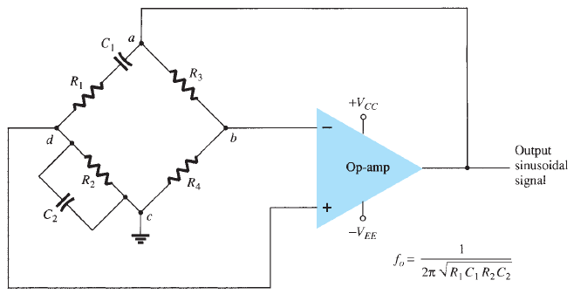
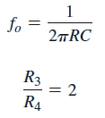
Wien Bridge Oscillator
If, in particular, the values are R1 = R2 = R and C1 = C2 = C,
the resulting oscillator frequency is
Notes:
A practical oscillator circuit uses an op-amp and RC bridge circuit, with the oscillator frequency set by the R and C components. Figures on slide shows a basic version of a Wien bridge oscillator circuit.
The Wien Bridge Oscillator is so called because the circuit is based on a frequency-selective form of the Wheatstone bridge circuit. The Wien Bridge oscillator is a two-stage RC coupled amplifier circuit that has good stability at its resonant frequency, low distortion and is very easy to tune making it a popular circuit as an audio frequency oscillator
Note the basic bridge connection resistors R 1 and R 2 and capacitors C 1 and C 2 form the frequency-adjustment elements, and resistors 3 and 4 form part of the feedback path. The op-amp output is connected as the bridge input at points a and c. The bridge circuit output at points b and d is the input to the op-amp.
Neglecting loading effects of the op-amp input and output impedances, the analysis of the bridge circuit results in
Thus a ratio of R 3 to R 4 greater than 2 will provide sufficient loop gain for the circuit to oscillate at the frequency calculated using Eq .

Slide 4
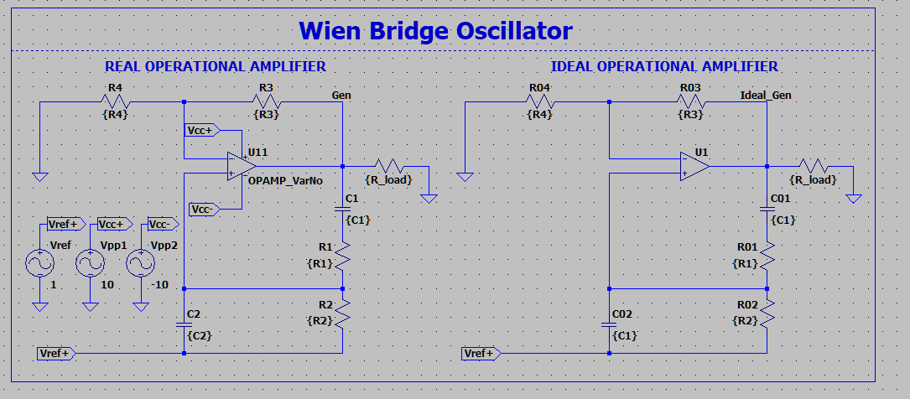
Wien Bridge Oscillator
If, in particular, the values are R1 = R2 = R and C1 = C2 = C,
the resulting oscillator frequency is
Notes:
A practical oscillator circuit uses an op-amp and RC bridge circuit, with the oscillator frequency set by the R and C components. Figures on slide shows a basic version of a Wien bridge oscillator circuit.
The Wien Bridge Oscillator is so called because the circuit is based on a frequency-selective form of the Wheatstone bridge circuit. The Wien Bridge oscillator is a two-stage RC coupled amplifier circuit that has good stability at its resonant frequency, low distortion and is very easy to tune making it a popular circuit as an audio frequency oscillator
Note the basic bridge connection resistors R 1 and R 2 and capacitors C 1 and C 2 form the frequency-adjustment elements, and resistors 3 and 4 form part of the feedback path. The op-amp output is connected as the bridge input at points a and c. The bridge circuit output at points b and d is the input to the op-amp.
Neglecting loading effects of the op-amp input and output impedances, the analysis of the bridge circuit results in
Thus a ratio of R 3 to R 4 greater than 2 will provide sufficient loop gain for the circuit to oscillate at the frequency calculated using Eq .

Slide 5
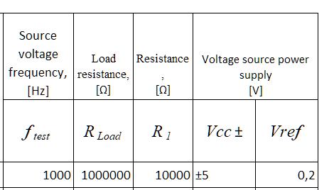
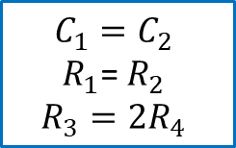
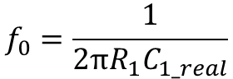
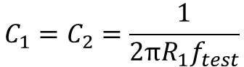
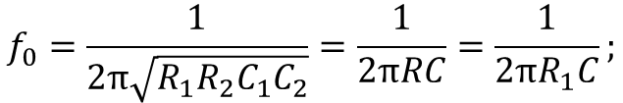
Wien Bridge Oscillator
$$f_{0}=\frac{1}{2π\sqrt{R_{1}R_{2}C_{1}C_{2}}}=\frac{1}{2πRC}=\frac{1}{2πR_{1}C};$$
$$C_{1}=C_{2}$$
$R_{1}$= $R_{2}$
$$R_{3}=2R_{4}$$
$$C_{1}=C_{2}=\frac{1}{2πR_{1}f_{test}}$$
Choose real capacitor
$$f_{0}=\frac{1}{2πR_{1}C_{1_real}}$$

Slide 6
Wien Bridge Oscillator

Slide 7
Wien Bridge Oscillator

Slide 8
Wien Bridge Oscillator

Slide 9
Wien Bridge Oscillator

Slide 10
Wien Bridge Oscillator

Slide 11
Wien Bridge Oscillator

Slide 12
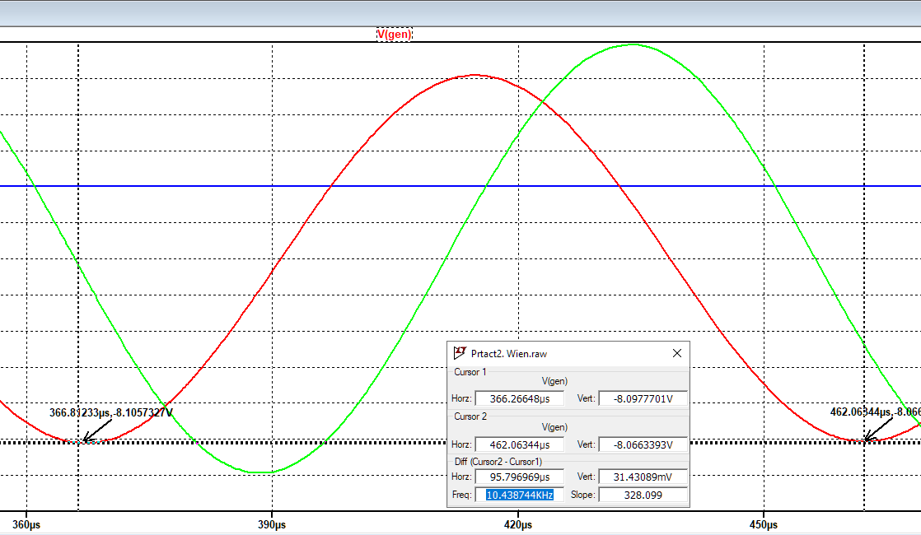
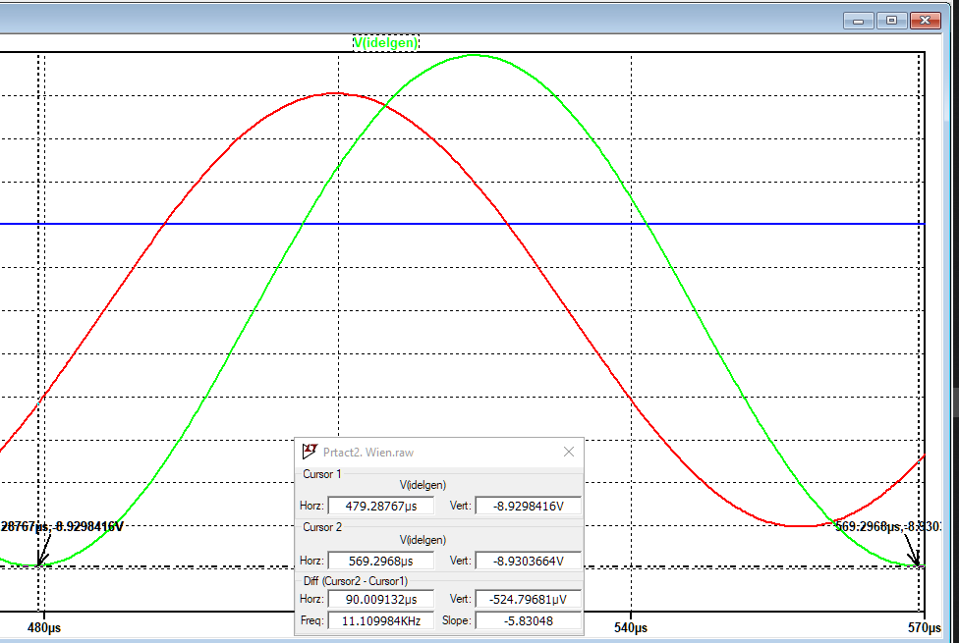
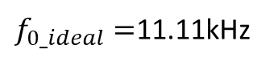
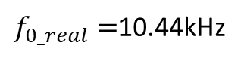
Wien Bridge Oscillator
$f_{0_real}=$10.44kHz
$f_{0_ideal}=$11.11kHz
Real operational amplifier
Ideal operational amplifier
$f_{0_calculated}=$ $\frac{1}{2π\sqrt{R_{1}R_{2}C_{1}C_{2}}}$= $\frac{1}{2π∗110∗10^{−12}∗130∗10^{3}}$=11,129kHz

Slide 13
Wien Bridge Oscillator
Real operational amplifier
Ideal operational amplifier

Slide 14

Test 2
https://forms.yandex.com/cloud/6372342c5d2a0664e323da80/
https://clck.ru/32gh38
1st deadline: 15.11.2022 15:15 (GMT +8)

Slide 15
Practice 3
1st deadline: 25.11.2022 15:15 (GMT +8)

Slide 16

Thanks for your attention!

